Slide 1
Customer Behavior & Churn Analysis
Regression Analysis & Business Insights
Zheng Zhu
15,000
31.9%
0.973
0.692
Total Customers
Churn Rate
Model AUC
Pseudo-R²
| February 2026

Slide 2
Agenda
01
Business Context
04
Key Findings and Insights
Industry overview, the churn problem, and why it matters to management
Five statistically significant drivers of customer churn
02
Research Questions
05
Recommendations
Five key questions driving this analysis
Five actionable strategies with expected business impact
03
Data & Methodology
Dataset overview, logistic regression approach, and model fit

Slide 3
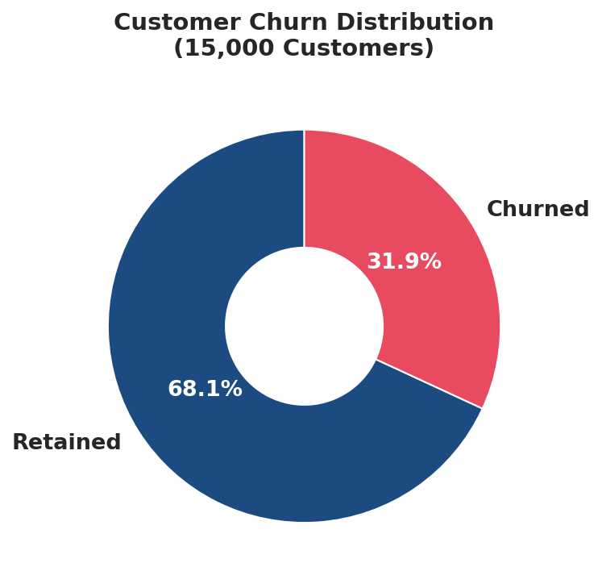
01
Business Context
The Industry Challenge
Churn Distribution
• Subscription-based services(Netflix, Spotify, ChatGPT etc.) face intense competition and low switching costs
• Customer retention is the primary means for sustainable revenue growth
• Acquiring a new customer costs 5–25× more than retaining an existing one (Gallo, 2014)
The Customer Behaviour & Churn Simulation Dataset (Kaggle)
• https://shorturl.at/nuPUR
The Business Problem
• 31.9% of customers churned during the observation period (4,783 of 15,000)
• At ~$59/month average revenue per user, this represents ~$1.7M in annual recurring revenue at risk
Why This Matters to Management
• A 5% reduction in churn rate can increase profits by 25–95% (Gallo, 2014)
• The regression model identifies specific, actionable levers — not just symptoms
10,216
Retained (68.1%)
4,74
Churned (31.9%)
• Early warning signals in the data enable targeted intervention before customers leave

Slide 4
02
Research Questions
Questions
• What are the primary statistically significant predictors of customer churn in a subscription-based digital services business, and what is the magnitude and direction of their effect on churn probability?
• Does lower customer satisfaction score significantly increase the probability of churn, and if so, how much does each unit decrease in satisfaction affect churn odds
• Do customers on longer-term (yearly) contracts exhibit significantly lower churn rates compared to those on monthly rolling contracts?
• Is the number of support tickets submitted a significant predictor of churn, indicating unresolved customer friction or dissatisfaction with the product experience?
• Does increased recency of disengagement — measured by days elapsed since last login — significantly predict churn, functioning as an early warning signal for customer at-risk status?
•Does customer tenure (months subscribed) reduce churn probability, and does this protective effect of loyalty persist after controlling for other factors?
10,216
Retained (68.1%)
4,74
Churned (31.9%)

Slide 5
03
Data & Methodology
Approach: Binary Logistic Regression
Model Performance
◆ 15,000 synthetic customer records, 21 features, no missing data
0.692
Pseudo R²
◆ 14 predictor variables including demographics, contract, behaviour, and support metrics
Excellent fit (>0.4 = outstanding)
◆ Target variable: churn (binary outcome, 0=Retained, 1=Churned)
0.973
ROC-AUC
◆ Maximum Likelihood Estimation (MLE) via statsmodels Logit
Near-perfect discrimination
◆ Class-weighted estimation to address 68/32 class imbalance
91.6%
Test Accuracy
◆ 80/20 train-test split for predictive performance validation
Data Description: See appendix
80/20 holdout sample
<0.001
Model p-value
Highly statistically significant

Slide 6
04
Key Findings — Five Drivers of Churn
Satisfaction Score
Contract Type
Support Tickets
Coef: -1.44
OR
0.24
Coef: -1.42
OR
0.24
Coef: +0.65
OR
1.92
p<0.001
p<0.001
p<0.001
1-pt increase in satisfaction → 76% lower churn odds
Annual contracts → 76% lower churn odds compared to monthly contracts
Each extra ticket nearly doubles churn odds (+92%)
Days Since Login
Tenure (months)
Coef: +0.09
OR
1.10
Coef: -0.05
OR
0.95
p<0.001
p<0.001
Each inactive day increases churn odds by 10%
Every extra month reduces churn odds by 5%
Note：OR is odd ratio=$\frac{p}{1−p}, p is the probality of churn$

Slide 7
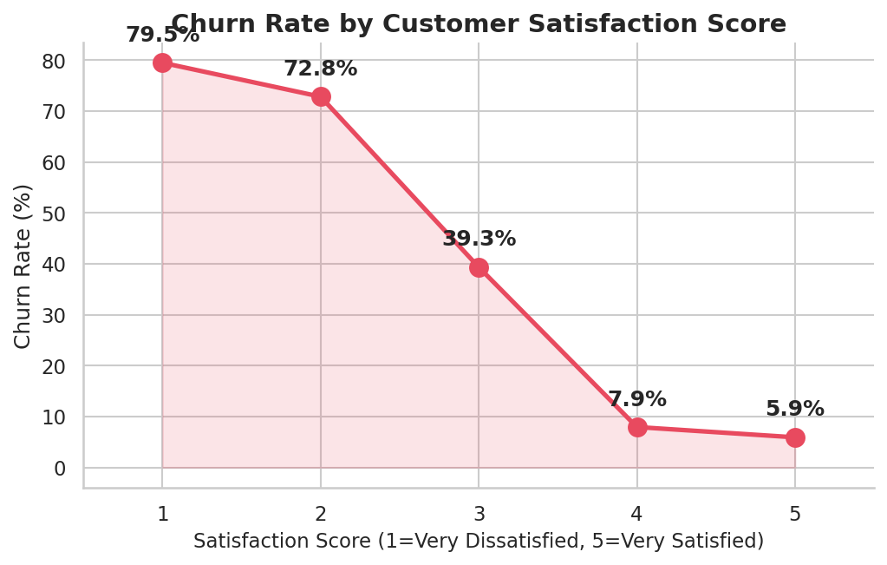
Finding 1
Satisfaction is the Master Variable of Churn
Key Takeaways
Score 1: ~80% churn rate
Score 2: ~73% churn rate
Score 3: ~39% churn rate
Score 4: ~8% churn rate
Score 5: ~6% churn rate
Regression result: Coef = -1.443, OR = 0.236, p<0.001 — the strongest predictor in the model. Each 1-point increase in satisfaction reduces churn odds by 76.4%.

Slide 8
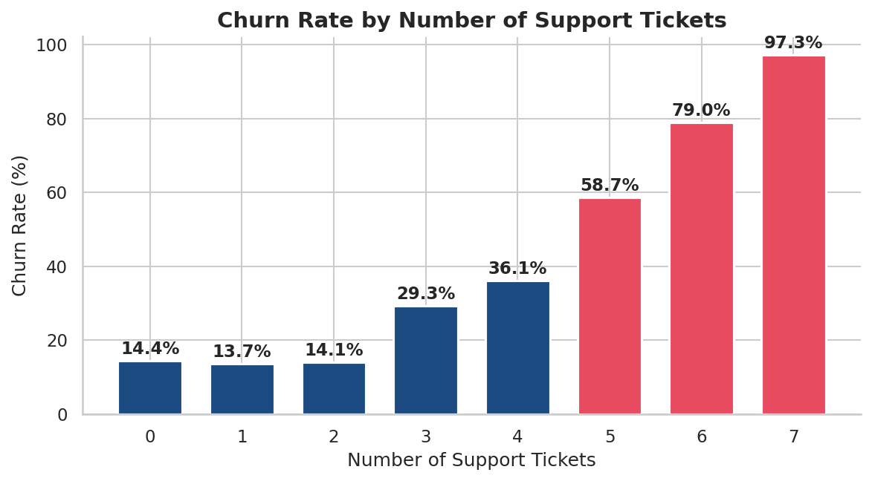
Findings 2 & 3
Contract Type & Support Tickets
📋 Contract Type
🎫 Support Tickets
monthly subscribers
yearly subscribers
~47.7%
churn rate
~19.7%
churn rate
Coef = -1.421 | OR = 0.241 | p<0.001
Annual contracts reduce churn odds by 75.9%
Coef = +0.652 | OR = 1.919 | p<0.001 — each extra ticket nearly doubles churn odds
Contract Type is a lever management — migrating customers from monthly to annual contracts is a structural approach to mitigate churn. Meanwhile, customers who have 3+ support tickets are a high-risk cohort requiring immediate, personalized remedy outreach.

Slide 9
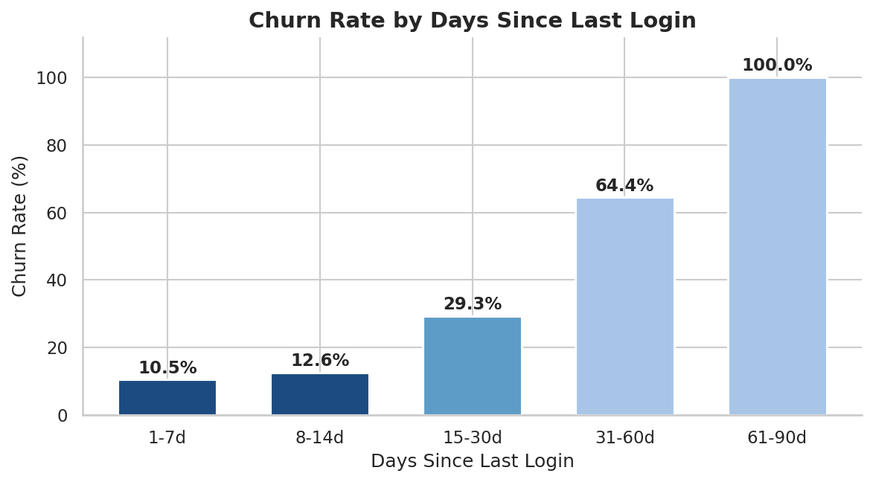
Findings 4 & 5
Login Recency & Customer Tenure
Finding 4: Days Since Last Login
Finding 5: Customer Tenure Effect
1–3 months
HIGH RISK
New customers — value not yet realized – 55% churn rate
4–12 months
MODERATE
Building habits and product familiarity – 46% churn rate
13–24 months
LOWER RISK
Established routines, higher loyalty – 22% churn rate
25+ months
LOWER RISK
Coef=0.093 | OR=1.097 per day | p<0.001
Long-term subscribers, deeply embedded – 23% churn rate
Coef=-0.050 | OR=0.951 per month | p<0.001

Slide 10
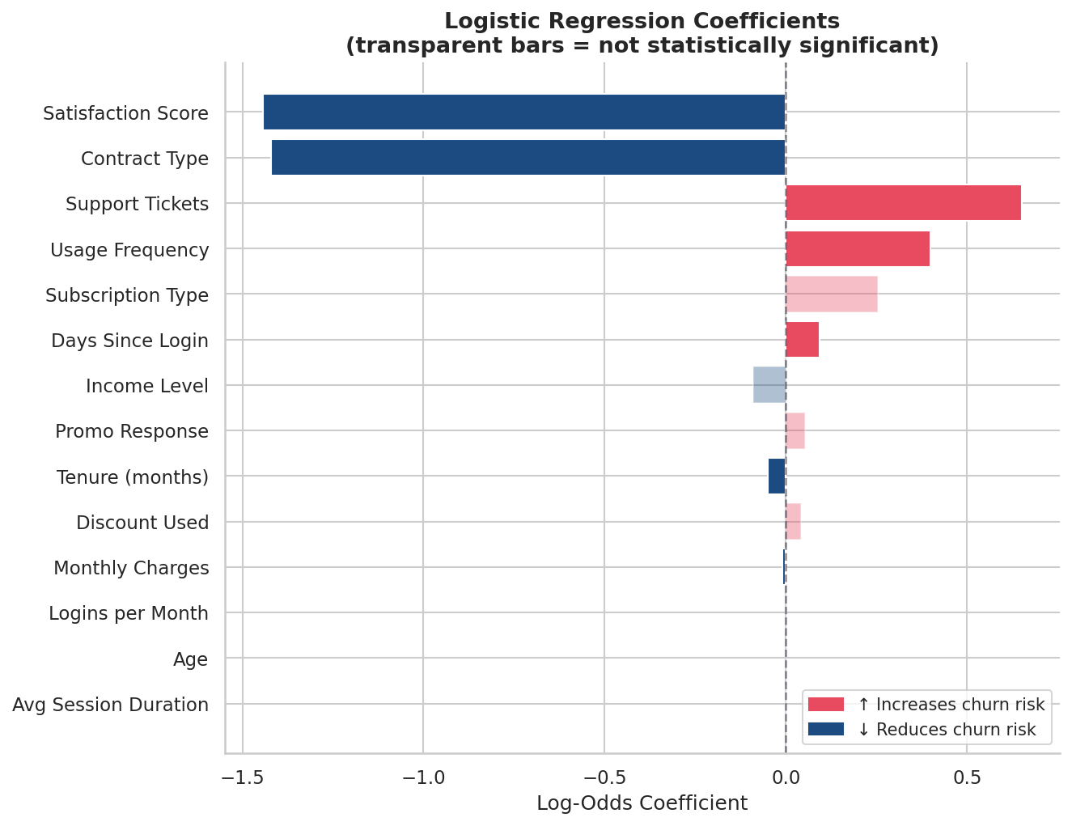
Model Summary
Predictor Coefficients — Full Logistic Regression Model
How to Read
Red bars (positive): predictor increases churn probability
Blue bars (negative): predictor reduces churn probability
Transparent bars: not statistically significant (p≥0.05)
Longer bar = stronger effect on churn
7 of 14 predictors are statistically significant. Satisfaction score and contract type are dominant.(see appendix)

Slide 11
05
Strategic Recommendations
R1
Real-Time Satisfaction Monitoring
Score-1→3 migration: estimated ~500 reduction in overall churn rate
Action: Launch milestone satisfaction surveys and escalate all low-tier (1–2) responses for urgent follow-up.
R2
Annual Contract Migration Campaign
20% migration → ~350 additional retained customers / year
Action: Drive annual plan adoption within the moderate-risk segment through a mix of financial discounts and value-added feature unlocks.
R3
High-Ticket Customer Rescue Programme
30% rescue rate → ~430 customers retained
Action: Auto-trigger senior CSM rescue at 3rd support ticket; personalized service and support
R4
Automated Login Re-Engagement System
5% recovery rate → 150+ customers retained per cycle, compounding annually
Action: Our re-engagement strategy involves tiered interventions: notifications at day 14, CSM calls at day 30, and specialized offers at day 60.
R5
90-Day Structured Onboarding
20% early churn reduction for new subscribers (~180)
Action: welcome call to engage customers, 30/60/90-day check-ins, satisfaction survey
Note: The impact estimation is available in the appendix on GitHub

Slide 12
Key Takeaways
1
Satisfaction score is the #1 driver — every point increase reduces churn odds by 76%
2
Annual contracts reduce churn 76% — a structural fix management can implement to mitigate churn
3
Support tickets number signal frustration — 3+ tickets implies crisis-level intervention needed
4
Login recency is a detectable, real-time churn signal requiring automated triggers
5
New subscribers are highest-risk — The first 90-day of onboarding is the most critical periods for customers retention。
Model: Logistic Regression | AUC = 0.973 | Pseudo-R² = 0.692 | N = 15,000

Slide 13
AI DISCLARMER
This presentation was developed by the author using the case materials, dataset and AI tools. ChatGPT and AI tool were used to provide guides, review the draft, provide feedback on clarity and structure, suggest edits for grammar and presentation flow, assist with formatting references in APA 7th edition, and support the generation of the presentation. All research, data preparation, quantitative analysis, visualizations, interpretations, and recommendations were conducted by the author with the assistance of AI. The author have reviewed and refined the whole output to ensure it aligns with the author’s perspective, therefore, the author is solely responsible for the content and conclusions. Use of AI was conducted in alignment with Hult’s AI policy (including appropriate disclosure and maintaining academic integrity).

Slide 14
Appendix — Full Regression Table
Variable | Coefficient | Std. Error | z-stat | p-value | Odds Ratio | Sig.
Satisfaction Score | -1.4427 | 0.0351 | -41.11 | <0.001 | 0.236 | ***
Contract Type (Yearly) | -1.4212 | 0.0742 | -19.14 | <0.001 | 0.241 | ***
Support Tickets | +0.6517 | 0.0184 | +35.37 | <0.001 | 1.919 | ***
Days Since Last Login | +0.0927 | 0.0027 | +34.52 | <0.001 | 1.097 | ***
Tenure (months) | -0.0501 | 0.0036 | -13.84 | <0.001 | 0.951 | ***
Usage Frequency | +0.3992 | 0.1304 | +3.06 | 0.002 | 1.491 | **
Monthly Charges | -0.0087 | 0.0033 | -2.64 | 0.008 | 0.991 | **
Subscription Type | +0.2545 | 0.1491 | +1.71 | 0.088 | 1.290 | n.s.
Income Level | -0.0894 | 0.0549 | -1.63 | 0.103 | 0.915 | n.s.
Promo Response | +0.0523 | 0.0709 | +0.74 | 0.461 | 1.054 | n.s.
Discount Used | +0.0409 | 0.0703 | +0.58 | 0.560 | 1.042 | n.s.
Age | +0.0007 | 0.0029 | +0.22 | 0.825 | 1.001 | n.s.
Avg Session Duration | +0.0002 | 0.0025 | +0.10 | 0.924 | 1.000 | n.s.
Logins per Month | +0.0014 | 0.0060 | +0.24 | 0.811 | 1.001 | n.s.
*** p<0.001 ** p<0.01 * p<0.05 n.s. = not significant (p≥0.05) | McFadden Pseudo-R² = 0.692 | AUC = 0.973 | N = 15,000

Slide 15
Reference
Gallo, A. (2014, October 29). The value of keeping the right customers. Harvard Business Review. https://hbr.org/2014/10/the-value-of-keeping-the-right-customers

Slide 16
Data and Code
https://www.kaggle.com/datasets/theaimindset/customer-behavior-and-churn-simulation-dataset
The dataset simulates customer behavior across a 12--24 month subscription lifecycle, enabling meaningful behavioral and retention analysis.
Total Records: 15000
Total Features: 21
Data Type: csv
Code
https://github.com/Snazz2001/churn_analysis/blob/main/churn_analysis.ipynb
Prompt
https://github.com/Snazz2001/churn_analysis/blob/main/impact_estimation.md

